Slide 1
Algorithmic Game Theory Lecture 2
Biaoshuai Tao

Slide 2
Games
A game is given by
a set of players N
for each player/agent i, a set of actions A_{i}
for each player/agent i, a utility function u_{i}: A₁ x ... x A_{n} → R (real numbers)
A vector of players’ actions (a₁, ..., a_{n}), a_{i} ∈ A_{i}, is called an action profile
each action profile corresponds to an outcome
u_{i} describes how much player i enjoys each outcome

Slide 3
Prisoners’ Dilemma
P2
Q
C
P1
(-1,-1) | (-4, 0)
(0, -4) | (-3, -3)
Q
C

Slide 4
Battle of Sexes
P2
Theatre
Football
P1
(2, 1) | (0, 0)
(0, 0) | (1, 2)
Theatre
Football

Slide 5
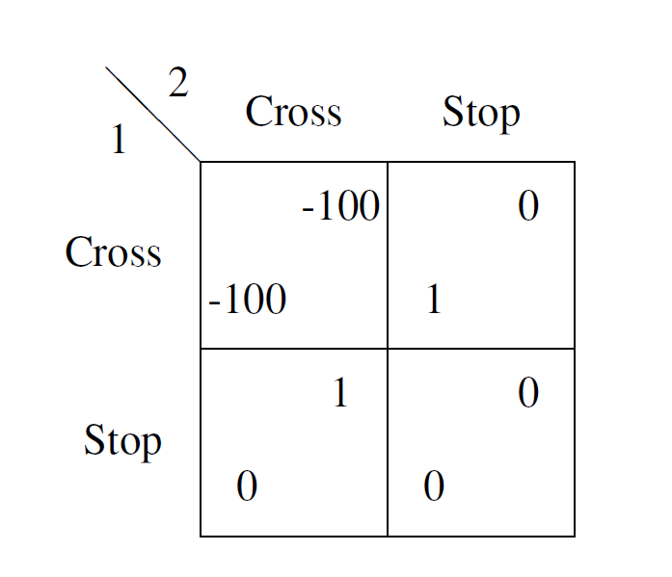
Children Game

Slide 6
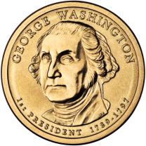
Matching Pennies
Heads
Tails
(1, -1) | (-1, 1)
(-1, 1) | (1, -1)
Heads
Tails

Slide 7
Mixed Strategies
A mixed strategy of a player in a strategic game is a probability distribution over that player’s actions
If the set of actions is {a¹, ..., a^{r}}, we will denote a mixed strategy by p = (p¹, ..., p^{r})
p^{i} ≥ 0 for i=1, ..., r, p¹+ ... + p^{r} = 1
Mixed strategy that assigns probability 1 to some action is called a pure strategy
Given a mixed strategy p, its support is defined by $supp\left(P\right)=\{a_{i}:p^{i}>0\}$

Slide 8
Nash Equilibrium
In an n-player game, a mixed strategy profile P = (p₁, ..., p_{n}) is called a Nash equilibrium if for any player i and any mixed strategy p’ of player i it holds that U _{i} (P) ≥ U _{i} (P_{-i}, p’)

Slide 9
Best Response
Consider any agent $i$. Given the strategies of the other agents $P_{−i}$, an action (pure strategy) $a_{i}∈A_{i}$ is a best response if $a_{i}$ maximizes $U_{i}(P_{−i}, ⋅)$.
Theorem. A strategy profile $P=\{P_{1},…,P_{n}\}$ is a Nash Equilibrium if and only if, for any agent $i$, $a_{i}∈supp(P_{i})$ is a best response to $P_{−i}$.

Slide 10
This Lecture: Complexity of Finding a NE
Zero-sum games:
Polynomial-time computable for two players
General number of players?
General games:
Lemke-Howson Algorithm (exponential time)
PPAD-complete

Slide 11
Zero-Sum Games

Slide 12
Zero-Sum Game
A game $\left(N,A_{1},…,A_{n},U_{1},…,U_{n}\right)$ is a zero-sum game if
$$\sum_{i=1}^{n}{U_{i}\left(a_{1},…,a_{n}\right)}=0$$
for any $\left(a_{1},…,a_{n}\right)∈A_{1}×⋯×A_{n}$.

Slide 13
Rock-Paper-Scissors
 |  | Player $2$
 |  | Rock | Scissors | Paper
Player $1$ | Rock | 0, 0 | 1, -1 | -1, 1
 | Scissors | -1, 1 | 0, 0 | 1, -1
 | Paper | 1, 1 | -1, 1 | 0, 0

Slide 14
Rock-Paper-Scissors
We can use only one number in each cell to represent a 2-player zero-sum game.
 |  | Player $2$
 |  | Rock | Scissors | Paper
Player $1$ | Rock | 0 | 1 | -1
 | Scissors | -1 | 0 | 1
 | Paper | 1 | -1 | 0

Slide 15
Payoff Matrix
$$A=\left[\begin{matrix}0 & 1 & −1 \\ −1 & 0 & 1 \\ 1 & −1 & 0\end{matrix}\right]$$
Given player 1’s strategy $x$ and player 2’s strategy $y$,
The utility for player 1 is $x^{⊤}Ay=\sum_{i,j}{A_{i,j}x_{i}y_{j}}$, and the utility for player 2 is $−x^{⊤}Ay=\sum_{i,j}{A_{i,j}x_{i}y_{j}}$.
Player 1 would like to maximizes $x^{⊤}Ay$, while player 2 would like to minimize $x^{⊤}Ay$.

Slide 16
von Neumann’s Minimax Theorem
Suppose $1$ chooses a strategy first. Knowing that $2$ will play the best response, $1$ will choose an optimal strategy $x$ that maximizes his/her utility:
$2$ plays the best response given $1$’s strategy $x$.
$$\max_{x} \min_{y}\sum_{i,j}{A_{i,j}x_{i}y_{j}}$$
Given $2$ plays the best response, $1$ chooses a strategy maximizing the utility.
Suppose $2$ chooses strategy first. Similarly, the utility for $1$ is
$$\min_{y} \max_{x} x^{⊤}Ay$$

Slide 17
von Neumann’s Minimax Theorem
Minimax Theorem:
$$\max_{x} \min_{y} x^{⊤}Ay=\min_{y} \max_{x} x^{⊤}Ay$$
Who chooses strategy first doesn’t matter!
Can be proved by LP-duality theorem.
$(x, y)$ is a Nash Equilibrium. (Why?)
A NE can be found by solving a linear program.
Polynomial-time solvable!

Slide 18
General Games
Existence of NE

Slide 19
Shifting Function $Φ$
We define a “shifting function” $Φ$ that maps a strategy profile $P$ to another strategy profile $Q$.
For an action (pure strategy) $a∈A_{i}$ of agent $i$, let $Δ_{i}\left(a,P\right)=U_{i}\left(a,P_{−i}\right)−U_{i}(P)$.
Define $Φ$ such that, in the output $Q$, agent $i$ plays $a$ with probability $\frac{P_{i}\left(a\right)+max\left\{Δ_{i}\left(a,P_{−i}\right),0\right\}}{1+\sum_{b∈A_{i}}{max\left\{Δ_{i}\left(b,P_{−i}\right),0\right\}}}$
Intuitively, in $Q$, each agent $i$ assigns larger probabilities to better strategies.

Slide 20
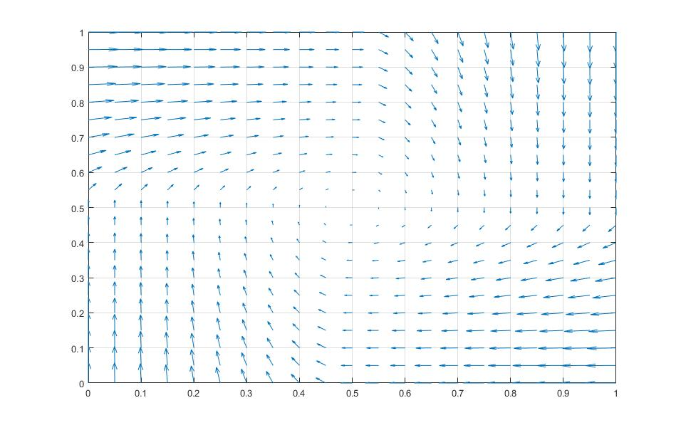
Matching Pennies: $Φ\left(P\right)−P$
Heads
Tails
(1, -1) | (-1, 1)
(-1, 1) | (1, -1)
Heads
Tails

Slide 21
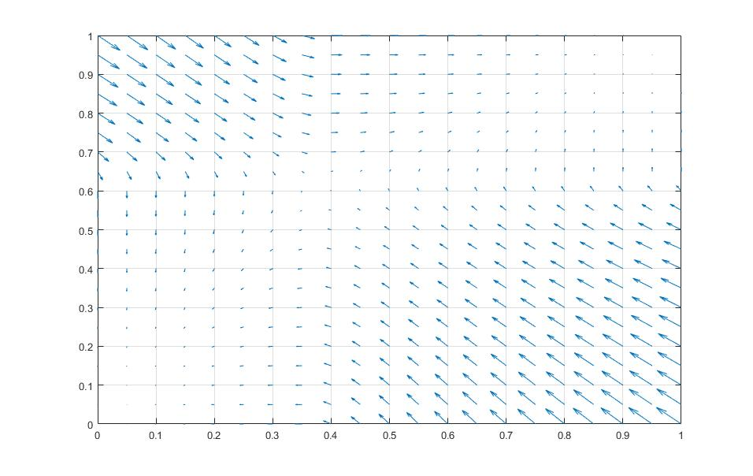
Battle of Sexes: $Φ\left(P\right)−P$
P2
Theatre
Football
P1
(2, 1) | (0, 0)
(0, 0) | (1, 2)
Theatre
Football

Slide 22
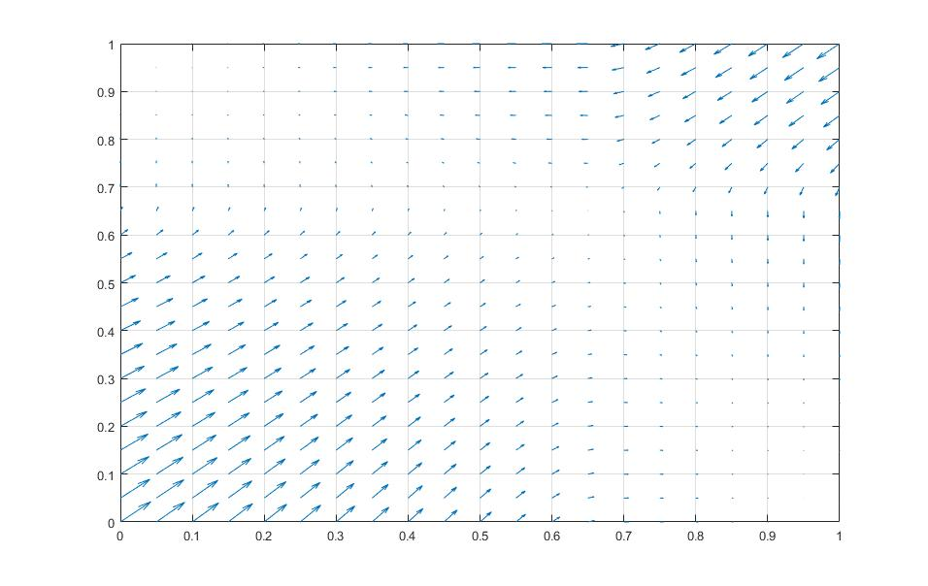
Children Game: $Φ\left(P\right)−P$

Slide 23
Brouwer’s Fixed Point Theorem
[Brouwer’s Fixed Point Theorem] Every continuous function $f$ that maps a convex compact space to itself has a fixed point $f\left(x\right)=x$.
The strategy space is clearly convex and compact.
$Φ$ is clearly continuous.
A fixed point of $Φ$ exists.
Brouwer’s Fixed Point Theorem implies the existence of NE.

Slide 24
General Two-Player Games
The Lemke-Howson Algorithm

Slide 25
Symmetric Games
P2
Q
C
P1
(-1,-1) | (-4, 0)
(0, -4) | (-3, -3)
Q
C
A two-player game can be represented by two matrices $A, B$.
Prisoners’ Dilemma Example: $A=\left[\begin{matrix}−1 & −4 \\ 0 & −3\end{matrix}\right],B=\left[\begin{matrix}−1 & 0 \\ −4 & −3\end{matrix}\right]$
A two-player game is symmetric if $A=B^{⊤}$
A NE $(x, y)$ is a symmetric NE if $x=y$
$\left(\left(0,1\right), \left(0,1\right)\right)$ is a symmetric NE for Prisoners’ Dilemma
$\left(\left(\frac{1}{3},\frac{1}{3},\frac{1}{3}\right),\left(\frac{1}{3},\frac{1}{3},\frac{1}{3}\right)\right)$ is a symmetric NE for Rock-Paper-Scissors

Slide 26
Reduction to Symmetric Games
Assuming symmetric games and only considering symmetric Nash Equilibria are WLOG.
General game $\left(A,B\right)$ reduce to symmetric game $C=\left[\begin{matrix}0 & A \\ B^{⊤} & 0\end{matrix}\right]$
Consider a symmetric NE $(z,z)$ where $z=\left[\begin{matrix}y \\ x\end{matrix}\right]$
Can you see that $(x, y)$ is a NE for $\left(A,B\right)$?
$z=\left[\begin{matrix}y \\ x\end{matrix}\right]$ must maximizes $z^{⊤}C\left[\begin{matrix}y \\ x\end{matrix}\right]=z^{⊤}\left[\begin{matrix}Ax \\ B^{⊤}y\end{matrix}\right]$, so $y$ maximizes $y^{⊤}Ax$ and $x$ maximizes $x^{⊤}B^{⊤}y=y^{⊤}Bx$
We will consider symmetric games from now on, and focuses on symmetric NEs!

Slide 27
Lemke-Howson Algorithm
Consider a symmetric game $A∈ℝ^{n×n}$ (so $A$ is the payoff matrix for player 1 and $A^{⊤}$ is the payoff matrix for player 2)
Assume $A$ contains no negative entry and no zero row/column
Consider the polytope $\{Az≤1, z≥0\}$ (with $2n$ linear constraints)
Each point $z$ represents a mixed strategy $x$, with $x_{i}=\frac{z_{i}}{z_{1}+⋯+z_{n}}$, except for the origin $0$.
Intuitively, a vertex of the polytope with tight constraint $A_{i}z=1$ implies $i$ is a best response to $x$. (Why?)

Slide 28
Lemke-Howson Algorithm
Consider the polytope $\{Az≤1, z≥0\}$
We say a pure strategy $i$ is represented at a vertex $z$ if either $z_{i}=0$ or $A_{i}z=1$ (or both).
A pure strategy can be represented at most twice.
The vertex $0$ represent each pure strategy exactly once.
A vertex $z≠0$ where each pure strategy is represented exactly once corresponds to a NE. (Why?)
Lemke-Howson Algorithm: find one such vertex

Slide 29
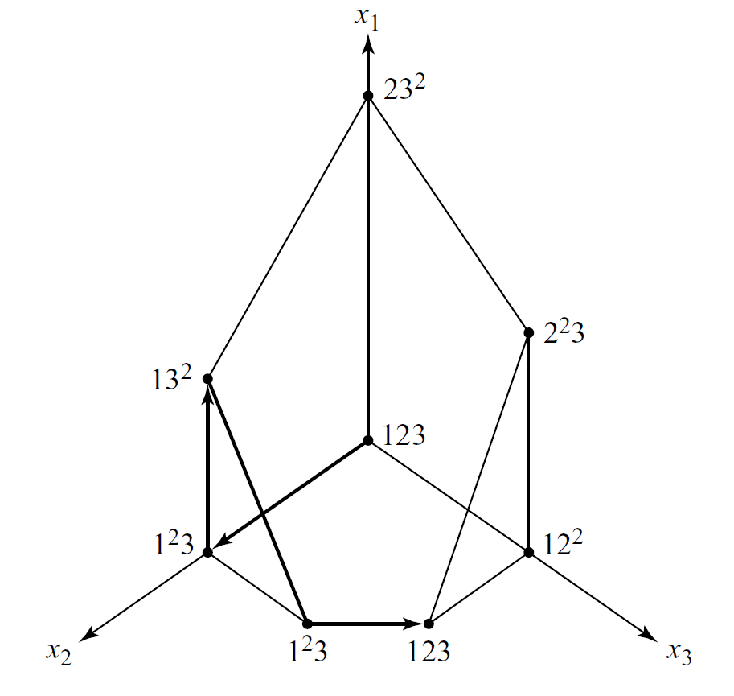
Lemke-Howson Algorithm
$$A=\left[\begin{matrix}0 & 3 & 0 \\ 0 & 0 & 3 \\ 2 & 2 & 2\end{matrix}\right]$$

Slide 30
Lemke-Howson Algorithm
Starting from the origin, and move from vertex to vertex until we find a vertex where all strategies are represented.
Choose a strategy, say, strategy $n$, that is allowed to be unrepresented.
Relax $z_{n}=0$, and move from the origin to its adjacent vertex.
Now, $n$ is unrepresented, and a strategy $i$ is represented twice: $z_{i}=0$ and $A_{i}z=1$.
Two adjacent vertices: relaxing $z_{i}=0$; relaxing $A_{i}z=1$
One of them is the origin, and move to the other one.
Now, if we are at a vertex where all strategies are represented, we are done.
Otherwise, a strategy $j$ is represented twice: $z_{j}=0$ and $A_{j}z=1$.
Two adjacent vertices: relaxing $z_{j}=0$; relaxing $A_{j}z=1$
One of them is the previous vertex, and move to the other one
Continue moving, until we get to a vertex where all strategies are represented…

Slide 31
Lemke-Howson Algorithm
$$A=\left[\begin{matrix}0 & 3 & 0 \\ 0 & 0 & 3 \\ 2 & 2 & 2\end{matrix}\right]$$

Slide 32
Lemke-Howson Algorithm
How can we guarantee the existence of a vertex representing all strategies?
Consider the vertices on the path travelled.
At most one strategy can be represented twice, and the two adjacent vertices corresponding to the “two representations”.
Each vertex has degree at most 2.
Thus, the path cannot self-intersect!
We will stop somewhere, as the number of vertices is finite.
In particular, we will not return to the origin. (Why?)

Slide 33
The Complexity Class PPAD
Consider a directed graph where vertices are represented by $n$-bit binary strings. (Exponentially number of vertices)
Each vertex’s in-degree and out-degree are at most 1.
So, the graph contains only paths and cycles.
Given vertex $v$, there is a polynomial-time algorithm to output its predecessor and successor
Problem: given a source vertex, compute a sink vertex.
PPAD (invented by Papadimitrious, stands for Polynomial Parity Argument (Directed))
Finding a NE belongs to PPAD.

Slide 34
Number of NEs
Most games have an odd number of NEs.
Can you see the intuitions behind this?

Slide 35
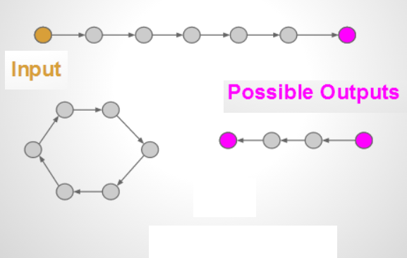
A Typical PPAD problem

Slide 36
PPAD-Formal Definition
A problem is in PPAD if it reduces to END_OF_THE_LINE.
END_OF_THE_LINE Problem
$G=(V,E)$ is a directed graph where vertices are represented by $n$-bit binary strings,
Every vertex have at most one predecessor and one successor
For each $v∈V$, poly-time computable $f(v)$ returns its predecessor and successor
Given function $f$ and a source $s∈V$, find a sink or another source

Slide 37
PPAD vs NP
PPAD problems are “easier” than NP-complete problems.
P = NP implies P = PPAD
Why do we believe PPAD-complete problems are “hard”?
To solve END_OF_THE_LINE, we need to “teleport” to short-cut the path leading from the source to the sink.
This does not seem easy for the most general case.

Slide 38
Some Typical PPAD-complete Problems
Finding a Nash equilibrium in a normal form game
Finding a fully-colored triangle in Sperner’s Lemma
Finding a fixed point in Brouwer’s fixed point theorem
Finding an envy-free cake cutting allocation with $n−1$ cuts

Slide 39
NASH is PPAD-complete

Slide 40
BROUWER
Consider a unit 3D cube subdivided into $2^{3n}$ equal cubelets, each of size $ε=2^{−n}$
a function $φ$ defined only on centers of cubelets: for each center $x$, $φ(x)$ can only take four values: $x+δ_{i}$, $i=0,1,2,3$
$δ_{1}=(ε,0,0)$, $δ_{2}=(0,ε,0)$, $δ_{3}=\left(0,0,ε\right)$
$δ_{0}=(−ε, −ε, −ε)$
and $φ(x)$ does not go outside the boundary...
A fixed point: a cubelet cornet point such that, among its eight adjacent cubelets, all four possible displacements $δ_{i}$, $i=0,1,2,3$ are presented
There always exists fixed points (Sperner’s Lemma)

Slide 41
PPAD-complete problem reduced from…
Daskalakis et al. (2006)
BROUWER is PPAD-complete.

Slide 42
Graphical Games
A directed graph $G=(V,E)$, in which players are vertices
$\left(i,j\right)∈E$ only if the utility of player $j$ depends on the strategy chosen by $i$

Slide 43
NASH is PPAD-hard: reduction from BROUWER
Reduction high level ideas:
All players have just two pure strategies $0$ and $1$...
so a mixed strategy is a real number in $[0,1]$
Construct 3 players to be the “leaders”, whose mixed strategies $x_{1},x_{2},x_{3}$ represent the coordinates in the unit cube.
Construct a gadget consists of many players:
taking the 3 leaders as input
output a player who always plays $1$ if $(x_{1},x_{2},x_{3})$ is a fixed point, and plays $0$ otherwise
Connect this output player to the 3 leaders, such that they receive high utility if the output player plays $1$.

Slide 44
Arithmetic and Logical Gadgets
We need to construct some gadgets simulating arithmetic and logical operations
multiplication gadget, addition gadget, subtraction gadget
AND gadget, OR gadget, NOT gadget
comparator gadget:
input $x$, output $y$, such that $y=1$ if $x>0.5$, and $y=0$ if $x<0.5$

Slide 45
Multiplication Gadget
4 players $a,b,c,d$
$a,b$, playing $1$ with probability $x_{a},x_{b}$ respective, are acted as input
$c$, acted as output, we want him to play $1$ with probability $x_{a}x_{b}$ in a subgame Nash equilibrium
$d$ intermediate player
$$a$$
$$d$$
$$c$$
$$b$$

Slide 46
Multiplication Gadget
$$a$$
$$d$$
$$c$$
$$b$$
player $d$
plays $1$: receive utility 1 if both $a,b$ play $1$, receive utility 0 otherwise
plays $0$: receive utility 1 if $c$ plays $1$, receive utility 0 otherwise
player $c$
utility 1 if he plays the same action as $c$, receive utility -1 otherwise
Easy to check that in a Nash equilibrium we must have $x_{c}=x_{a}x_{b}$ and $x_{d}=0.5$.

Slide 47
We can construct the other gadgets similarly...

Slide 48
Finally...
For the 3 leaders playing mixed strategies $x_{1},x_{2},x_{3}$ respectively,
use a series of comparators and substractors to extract the $n$ most significant bits of $x_{1},x_{2},x_{3}$
identify the cubelet that the point $\left(x_{1},x_{2},x_{3}\right)$ is in
construct gadget to compute $φ$ (using AND, OR, NOT gadgets)
check if all four possible displacements $δ_{i}$, $i=0,1,2,3$ are presented in the 8 neighbor cubelets
output an indicator player, and connected it to the 3 leaders.
Done!

Slide 49
Further Results
(Chen and Deng, 2005b) & (Daskalakis and Papadimitrious, 2005)
Finding a Nash equilibrium in a 3-player game is PPAD-complete.
(Chen and Deng, 2005a)
Finding a Nash equilibrium in a 2-player game is PPAD-complete.

