Slide 1
Algorithmic Game Theory Lecture 3
Biaoshuai Tao

Slide 2
Social Choice
Aggregating individuals’ opinions/preferences/interests to reach a collective decision.
Voting
Fair division
Etc.

Slide 3
Social Choice
A set of alternatives/candidates $A$
A set of $n$ agents/voters
Each agent/voter $i$ has a total order $<_{i}$ over $A$, describing his/her preference.
$L$: the set of all $|A|!$ possible preferences.
Social Welfare Function $F:L^{n}→L$
Social Choice Function $f:L^{n}→A$

Slide 4
Social Welfare Function
What is a good solution for two alternatives $\left|A\right|=2$?
ANS: majority vote
How about $\left|A\right|>2$?
Condorcet’s Paradox
$a>_{1}b>_{1}c$
$b>_{2}c>_{2}a$
$c>_{3}a>_{3}b$

Slide 5
Good Properties for Social Welfare Functions
[Unanimity] If $a<_{i}b$ for every voter $i$, then $a<b$ where $F\left(<_{1},…,<_{n}\right)= <$.
[Non-dictatorship] There does not exist a voter $i$ such that $F\left(<_{1},…,<_{n}\right)= <_{i}$ always holds.
[Independence of Irrelevant Alternatives (IIA)] The output relation between $a,b$ only depends on agents’ preferences over $a,b$, and is irrelevant to any other alternative $c$.
[IIA] Formally, for every $a,b$ and every $<_{1},…,<_{n},<_{1}^{′},…,<_{n}^{′}∈L$, if we denote $F\left(<_{1},…,<_{n}\right)= <$ and $F\left(<_{1}^{′},…,<_{n}^{′}\right)= <^{′}$, then $a<_{i}b⟺a<_{i}^{′}b$ for all $i$ implies that $a<b⟺a<^{′}b$.

Slide 6
Arrow’s Impossibility Theorem
[Arrow’s Impossibility Theorem]
Every social welfare function $F$ for $\left|A\right|≥3$ fails at least one of the followings:
Unanimity
IIA
Non-dictatorship

Slide 7
Proof of Arrow’s Theorem
Suppose $F$ satisfies unanimity and IIA. We will show $F$ is a dictatorship.
Lemma [Pairwise Neutrality]. Let $>_{1},…,>_{n}$ and $>_{1}^{′},…,>_{n}^{′}$ be two profiles such that, for every player $i$, $a>_{i}b⟺c>_{i}^{′}d$. Then $a>b⟺c>^{′}d$ where $> =F\left(>_{1},…,>_{n}\right)$ and $>^{′}=F\left(>_{1}^{′},…,>_{n}^{′}\right)$.
Proof. Assume $a>b$ WLOG (by renaming the alternatives).

Slide 8
Pairwise Neutrality
Merge $>_{i}$ and $>_{i}^{′}$ as follows
By IIA, the order of $a,b$ is not changed in $>$; the order of $c,d$ is not changed in $>^{′}$.
By IIA, we assume $>_{i}= >_{i}^{′}$ since we only care about $a,b,c,d$
By unanimity, we have $c>a$ and $b>d$
Since we have assumed $a>b$, we have $c>d$, so $c>^{′}d$.

Slide 9
Proof of Arrow’s Theorem (Continued)
Now, consider any $a≠b∈A$.

Slide 10
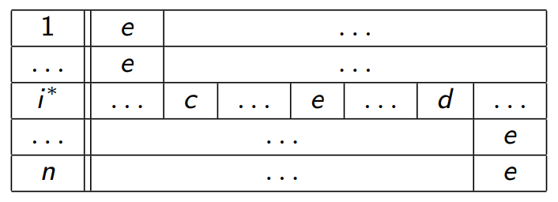
Prove that $i^{∗}$ is the dictator.
Consider any two alternatives $c≠d∈A$, and a third alternative $e∈A$
We aim to show $c>_{i^{∗}}d⟹c>d$.
Consider the following modified profile with $e$’s position changed:
By IIA, this modification does not change the order of $c,d$ in $>$
$(c,e)$ appears in the same way as $(a,b)$ before, so Pairwise Neutrality implies $c>e$. Similarly, $c>d$.
Thus, $c>d$.

Slide 11
Social Choice Function
Social Choice Function $f:L^{n}→A$
What are the good properties for a social choice function?
IIA does not apply

Slide 12
Strategy-Proofness
A social choice function $f$ can be strategically manipulated by voter $i$ if, for some $<_{1},…,<_{n}∈L$ and some $<_{i}^{′}∈L$, we have $a<_{i}a′$ where $a=f\left(<_{1},…,<_{i},…,<_{n}\right)$ and $a^{′}=f\left(<_{1},…,<_{i}^{′},…,<_{n}\right)$.
$f$ is strategy-proof if it is not strategically manipulatable by any agent.
Strategy-Proof/Truthful/Incentive-Compatible:
“truth-telling is a dominant strategy”

Slide 13
Majority Vote
Majority Vote: $f(<_{1},…,<_{n})$ outputs $a∈A$ where $a$ is ranked top for most agents.
Is it strategy-proof?
For two alternatives?
For more than two alternatives?
ANS: yes for two alternatives; no for more than two alternatives…

Slide 14
Strategy-Proofness for $>2$ Alternatives
Can you design a strategy-proof social choice function for more than two alternatives?
[Not “onto”] Choose $a,b∈A$ such that $f$ is only allowed to output $a$ or $b$. Then implement majority vote for $A^{′}=\left\{a,b\right\}$.
[Dictatorship] $f$ outputs the top-ranking alternative for agent 1

Slide 15
Gibbard-Satterthwaite Theorem
For $\left|A\right|≥3$, any social choice function $f$ fails at least one of the followings:
$f$ is strategy-proof
$f$ is onto
$f$ is not a dictatorship
Onto: For any $a∈A$, there exist $<_{1},…,<_{n}∈L$ such that $a=f\left(<_{1},…,<_{n}\right)$.
Dictatorship: There exists an agent $i$ such that $a=f\left(<_{1},…,<_{n}\right)$ whenever $a$ is maximum in $<_{i}$.

Slide 16
Proof Sketch
Suppose $f$ satisfies strategy-proofness, onto, and non-dictatorship.
Extend $f$ to a social welfare function $F$.
Show that $F$ satisfies unanimity, IIA, and non-dictatorship.
Arrow’s impossibility theorem gives a contradiction.

Slide 17
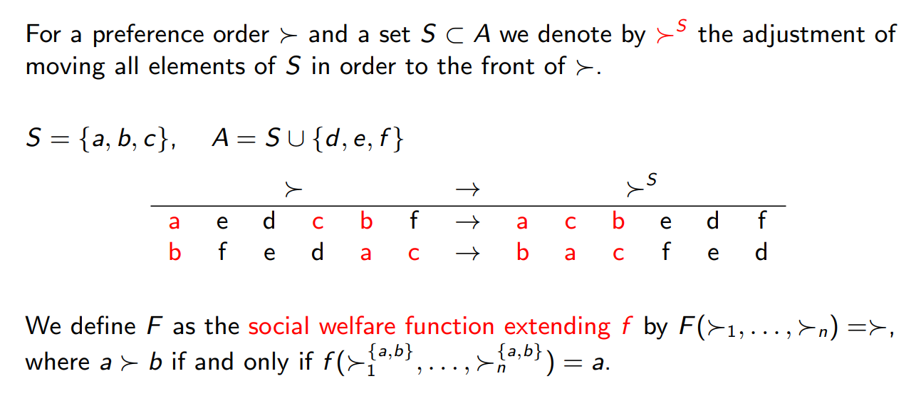
Extending $f$ to $F$

Slide 18
Exercise
To complete the proof of Gibbard-Satterthwaite Theorem, we need to prove
The output of $F$ is a total order, so that the extension is valid.
The extended social welfare function $F$ satisfies unanimity, IIA, and non-dictatorship.
Exercise!

Slide 19
Bypassing Gibbard-Satterthwaite Theorem
Bypassing the impossibility result of Gibbard-Satterthwaite Theorem:
Mechanism with Money [this lecture]
Restricted Domain of Preferences [future lecture (probably)]

Slide 20
Social Choice with Money
Previous model: $a<_{i}b$ says $i$ prefers $b$ to $a$, but it does not say “by how much”
New model: Each agent $i$ has a valuation function $v_{i}:A→ℝ$
New social choice function: $f$ takes $n$ valuation functions as inputs, and outputs a winning alternative.
Can we design $f$ that is strategy-proof, onto, and non-dictatorship?
With Money: $f\left(v_{1},…,v_{n}\right)=\left(a, m_{1},…,m_{n}\right)$
$a$: the winning alternative
$m_{i}$: amount of money that agent $i$ needs to pay
Quasilinear utility: $u_{i}=v_{i}\left(a\right)−m_{i}$

Slide 21
Single-Item Auction
An item is going to be allocated to one of the $n$ agents
This item is worth $v_{i}$ to agent $i$
We have $n$ alternatives: $A=\left\{a_{1},…,a_{n}\right\}$
$a_{i}$: allocate the item to agent $i$
[Objective] Design $f$ such that $f\left(v_{1},…,v_{n}\right)=\left(a_{i},m_{1},…,m_{n}\right)$ where
$v_{i}$ is the maximum among $v_{1},…,v_{n}$
$f$ is strategy-proof
Attempt 1: no payment: $m_{1}=⋯=m_{n}=0$
Attempt 2: pay your bid (first-price auction): $m_{i}=v_{i}$, $m_{j}=0$ for $j≠i$

Slide 22
Vickrey’s Second Price Auction
$f\left(v_{1},…,v_{n}\right)=\left(a_{i},m_{1},…,m_{n}\right)$ where
$v_{i}$ is the highest
$m_{i}=v_{i^{′}}$ where $v_{i^{′}}$ is the second-highest
$m_{j}=0$ for $j≠i$
$f$ is strategy-proof. Can you see why?

Slide 23
Mechanism with Money - Setting
A set of alternatives $A$
Each agent $i$ has a valuation function $v_{i}:A→ℝ_{≥0}$
$V$: the set of all possible valuation functions
A mechanism is a collection of $n+1$ functions $\left(f,p_{1},…,p_{n}\right)$ where
$f:V^{n}→A$ takes $n$ valuation functions as inputs and outputs the winning alternative
$p_{i}:V^{n}→ℝ$ takes $n$ valuation functions as inputs and outputs the amount of money agent $i$ needs to pay
Strategy-Proofness: for any $i$ and any $v_{i}^{′}$, we have $v_{i}\left(f\left(v_{i},v_{−i}\right)\right)−p_{i}\left(v_{i},v_{−i}\right)≥v_{i}\left(f\left(v_{i}^{′},v_{−i}\right)\right)−p_{i}\left(v_{i}^{′},v_{−i}\right)$

Slide 24
VCG Mechanisms
A mechanism $\left(f,p_{1},…,p_{n}\right)$ is called a Vickery-Clarke-Groves (VCG) mechanism if
The output alternative maximizes the social welfare
$$f\left(v_{1},…,v_{n}\right)∈{argmax}_{a∈A}\sum_{i=1}^{n}{v_{i}\left(a\right)}$$
Each payment function $p_{i}$ is of the following format
$$p_{i}\left(v_{1},…,v_{n}\right)=h_{i}\left(v_{1},…,v_{n}\right)−\sum_{j≠i}{v_{j}\left(f\left(v_{1},…,v_{n}\right)\right)}$$
where $h_{i}$ is some function that does not depend on $v_{i}$:
$$∀v_{i},v_{i}^{′}: h_{i}\left(v_{1},…,v_{i},…,v_{n}\right)=h_{i}\left(v_{1},…,v_{i}^{′},…,v_{n}\right)$$

Slide 25
Strategy-Proofness of VCG
Theorem. Every VCG mechanism is strategy-proof.
Proof [Sketch]. For each agent $i$, his/her utility is given by
$$u_{i}\left(v_{1},…,v_{n}\right)=v_{i}\left(f\left(v_{1},…,v_{n}\right)\right)−p_{i}\left(v_{1},…,v_{n}\right)$$
$$=v_{i}\left(f\left(v_{1},…,v_{n}\right)\right)−h_{i}\left(v_{1},…,v_{n}\right)+\sum_{j≠i}{v_{j}\left(f\left(v_{1},…,v_{n}\right)\right)}$$
$$=−h_{i}\left(v_{1},…,v_{n}\right)+\sum_{j=1}^{n}{v_{j}\left(f\left(v_{1},…,v_{n}\right)\right)}$$
Agent $i$’s utility is given by the social welfare minus some term that is independent of his “action” $v_{i}$.
Truth-telling maximizes his/her utility as VCG maximizes social welfare.

Slide 26
Intuitions Behinds VCG
$$p_{i}\left(v_{1},…,v_{n}\right)=h_{i}\left(v_{1},…,v_{n}\right)−\sum_{j≠i}{v_{j}\left(f\left(v_{1},…,v_{n}\right)\right)}$$
$$u_{i}\left(v_{1},…,v_{n}\right)=−h_{i}\left(v_{1},…,v_{n}\right)+\sum_{j=1}^{n}{v_{j}\left(f\left(v_{1},…,v_{n}\right)\right)}$$
The payment function is set such that each agent’s utility is aligned with the social welfare.

Slide 27
The Choice of $h_{i}$
We have seen that every VCG mechanism is
Social Welfare Maximizing, and
Strategy-Proof
How to choose $h_{i}$ in the payment function $p_{i}=h_{i}−\sum_{j≠i}{v_{j}\left(a\right)}$?
[No Positive Transfer] We want the payment to be non-negative:
Setting $h_{i}=0$ is not good!
[Individual Rational] We want each agent to have non-negative utility:
$h_{i}$ cannot be too large!

Slide 28
Clarke Pivot Rule
$$h_{i}\left(v_{1},…,v_{n}\right)=\max_{b∈A}\sum_{j≠i}{v_{j}\left(b\right)}$$
$h_{i}$ is the highest social welfare if agent $i$ is excluded from the game.
The payment $p_{i}=h_{i}−\sum_{j≠i}{v_{j}\left(a\right)}=\sum_{j≠i}{v_{j}\left(b\right)}−\sum_{j≠i}{v_{j}\left(a\right)}$ is the damage to the social welfare due to agent $i$’s participation.

Slide 29
Properties of Payment Function
$$p_{i}\left(v_{1},…,v_{n}\right)=\max_{b∈A}\sum_{j≠i}{v_{j}\left(b\right)}−\sum_{j≠i}{v_{j}\left(f\left(v_{1},…,v_{n}\right)\right)}$$
Non-negative payment: $b$ maximizes $\sum_{j≠i}{v_{j}\left(⋅\right)}$
Non-negative utility:
$u_{i}=−\max_{b∈A}\sum_{j≠i}{v_{j}\left(b\right)}+\sum_{j=1}^{n}{v_{j}\left(f\left(v_{1},…,v_{n}\right)\right)}$
$\sum_{j≠i}{v_{j}\left(b\right)}≤\sum_{j=1}^{n}{v_{j}\left(b\right)}$
$f\left(v_{1},…,v_{n}\right)$ maximizes $\sum_{j=1}^{n}{v_{j}\left(⋅\right)}$

Slide 30
VCG with Clarke Pivot Rule
A mechanism $\left(f,p_{1},…,p_{n}\right)$ is called a Vickery-Clarke-Groves (VCG) mechanism if
The output alternative maximizes the social welfare
$$f\left(v_{1},…,v_{n}\right)∈{argmax}_{a∈A}\sum_{i=1}^{n}{v_{i}\left(a\right)}$$
Each payment function $p_{i}$ is of the following format
$$p_{i}\left(v_{1},…,v_{n}\right)=\max_{b∈A}\sum_{j≠i}{v_{j}\left(b\right)}−\sum_{j≠i}{v_{j}\left(f\left(v_{1},…,v_{n}\right)\right)}$$

Slide 31
Second-Price Auction (Revisited)
Second-Price Auction: The agent with the highest bid wins, and pay for the second-highest bid.
Second-Price Auction is a special case of VCG with Clarke Pivot
Let $i^{∗}$ be the winner.
For each $i≠i^{∗}$:
$h_{i}=\max_{a_{i}∈A}\sum_{j≠i}{v_{j}\left(a_{i}\right)}=v_{i^{∗}}$ and $\sum_{j≠i}{v_{j}\left(f\left(v_{1},…,v_{n}\right)\right)}=v_{i^{∗}}$
So the payment is $0$
For agent $i^{∗}$:
$h_{i^{∗}}=\max_{a_{i}∈A}\sum_{j≠i^{∗}}{v_{j}\left(a_{i}\right)}$ is the second-highest bid and $\sum_{j≠i^{∗}}{v_{j}\left(f\left(v_{1},…,v_{n}\right)\right)}=0$
So the payment is exactly the second-highest bid

Slide 32
Multiunit Auction
$k$ identical items are sold to $n$ agents (with $k<n$)
Each agent is only interested in one item
Each agent $i$ has value $v_{i}$ to one item
What will VCG do?
ANS: Allocate items to the $k$ agents with the highest bids, and charge each of them the $(k+1)$-th highest bid.
Heterogeneous items and general valuations?
Combinatorial Auction [Chapter 11 of the Textbook]

Slide 33
Combinatorial Auction
A set $M$ of $m$ items
A set of $n$ agents
Each agent $i$’s valuation function $v_{i}:{\{0,1\}}^{M}→ℝ_{≥0}$
We can run VCG to get strategy-proofness and social-welfare-maximizing. However, …
Exponential running time:
Number of “alternatives”: $n^{m}$

Slide 34
This Lecture
Social choice
Arrow’s impossibility theorem
Gibbard-Satterthwaite Theorem
Strategy-proof is impossible
Social choice with money
VCG mechanism (with Clarke Pivot Rule)
Maximizes social welfare
Enable strategy-proofness

